Slide 1





Processing Redis with .NET
How to Operate with Redis Databases
Database Applications
SoftUni Team
Technical Trainers
Software University
http://softuni.bg

Slide 2

Working with Redis .NET API

Slide 3
Working with Redis and .NET
Install the Redis Client of ServiceStack.Net
Storing objects into memory:
Install-Package ServiceStack.Redis
var redis = new RedisClient();
var redisLogs = redis.As<Log>();
redisLogs.Store(new Log()
{
Id = redisLogs.GetNextSequence(),
Text = "Log crated on " + DateTime.Now,
LogDate = DateTime.Now
});
Saves object into memory

Slide 4
Fetching Stored Data with Redis
var redis = new RedisClient();
var redisLogs = redis.As<Log>();
var logs = redisLogs.GetAll()
.Select(l => string.Format("[{0}] {1}", l.LogDate, l.Text));
foreach (var log in logs)
{
Console.WriteLine(log);
}

Slide 5
Using Redis with .NET
Live Demo

Slide 6
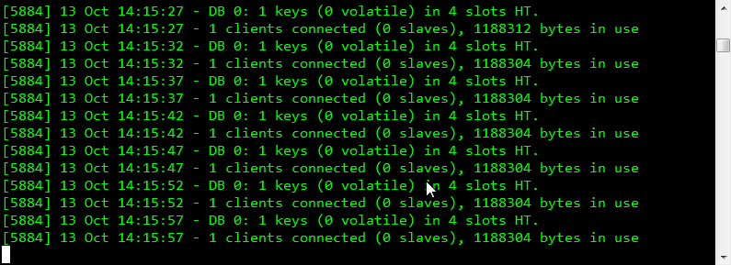
Redis Clients

Slide 7
Redis Clients
The ServiceStack Redis API provides three different clients to work with the data:
IRedisNativeClient
IRedisClient
IRedisTypedClient
IRedisNativeClient client = new RedisClient();
IRedisClient client = new RedisClient();
RedisClient client = new RedisClient();

Slide 8
Redis Clients
Live Demo

Slide 9

Database Persistence

Slide 10
Redis Persistence
Redis runs in the main memory (RAM)
That is the reason to be that fast
Redis saves the data on the disk at a given period
By default:
save 900 1 // 1 key for 900 seconds
save 300 10 //10 keys for 300 seconds
save 60 10000 // 10000 keys for 60 seconds
apendonly yes // persist data every time

Slide 11
Database Persistence
Live Demo

Slide 12









Processing Redis with .NET
https://softuni.bg/courses/database-applications/

Slide 13
License
This course (slides, examples, demos, videos, homework, etc.) is licensed under the "Creative Commons Attribution-NonCommercial-ShareAlike 4.0 International" license
Attribution: this work may contain portions from
"Databases" course by Telerik Academy under CC-BY-NC-SA license

Slide 14





Free Trainings @ Software University
Software University Foundation – softuni.org
Software University – High-Quality Education, Profession and Job for Software Developers
softuni.bg
Software University @ Facebook
facebook.com/SoftwareUniversity
Software University @ YouTube
youtube.com/SoftwareUniversity
Software University Forums – forum.softuni.bg

